Slide 2
INTRO TO TECHNICAL WRITING

Slide 3
Overview
What is Technical Writing?
Why do I have to learn about it?
Key Features of Technical Writing
Course Overview

Slide 4
WHAT IS TECHNICAL WRITING?

Slide 5

What is technical writing?
From TWE: “Technical Writing is a genre of non-fiction writing that encompasses not only technical materials such as manuals, instructions, specifications, and software documentation, but it also includes writing produced in day-to-day business operations such as correspondence, proposals, internal communications, media releases, and many kinds of reports. It includes the communication of specialized technical information, whether relating to computers and scientific instruments, or the intricacies of meditation. And because oral and visual presentations are such an important part of professional life, technical communication also encompasses these as well.” (5)
One of the first examples of technical writing from 3100-3000 BCE recorded workers’ daily beer ration
https://britishmuseum.withgoogle.com/object/the-first-writing-counting-beer-for-the-workers

Slide 6
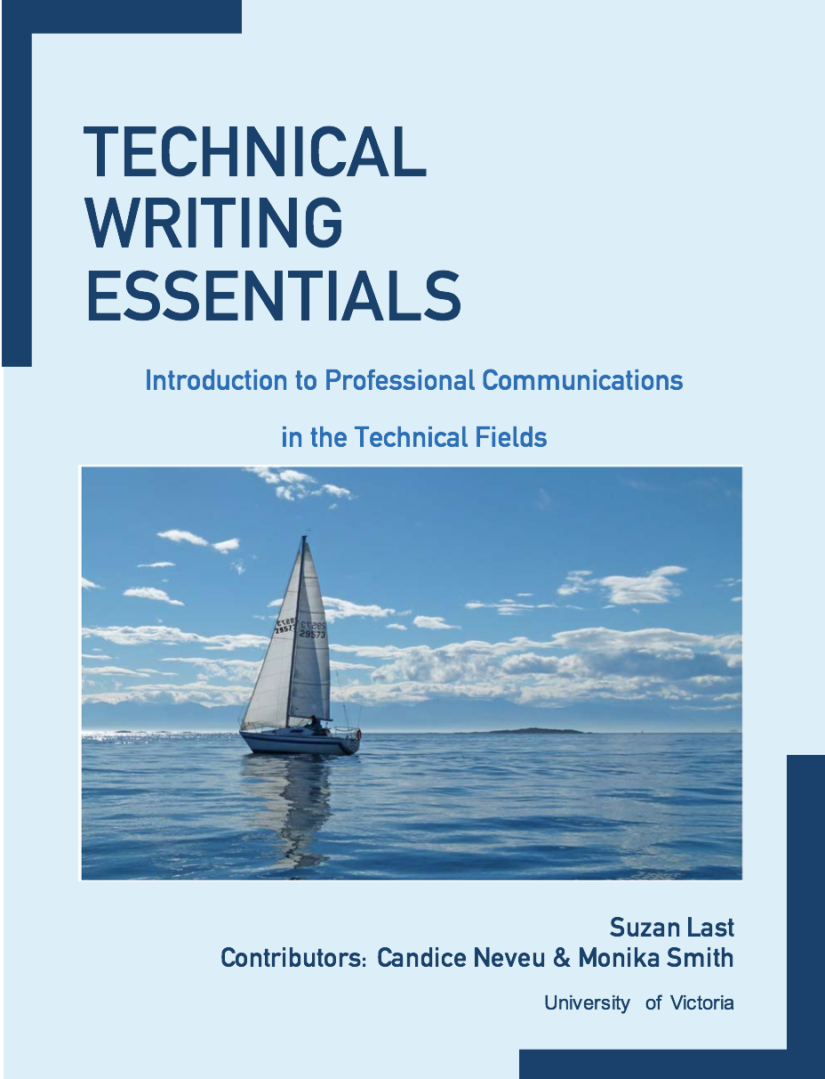
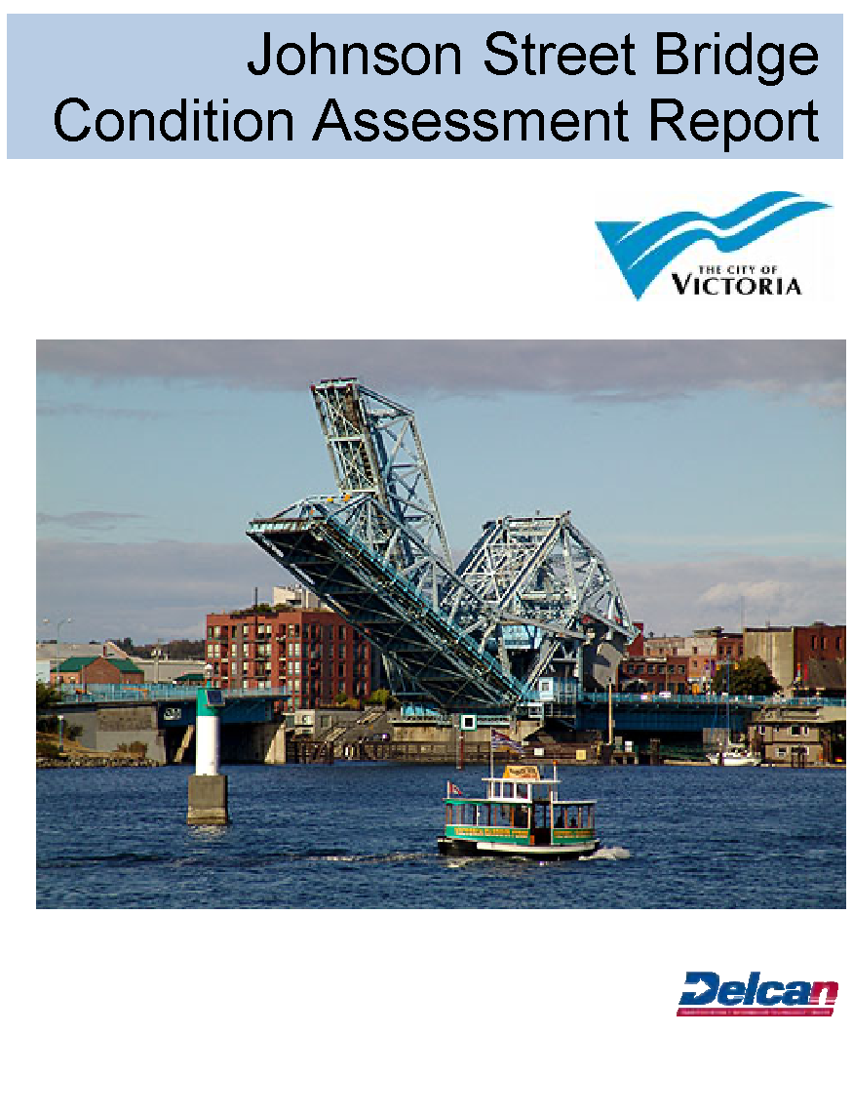
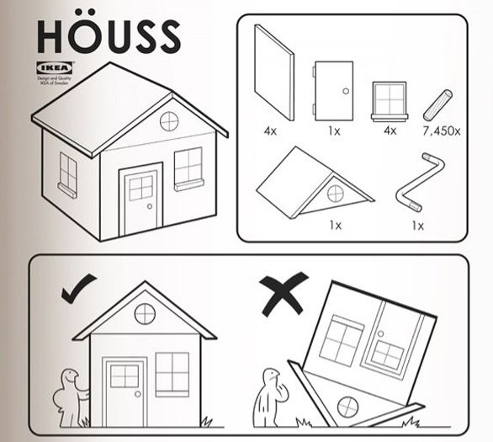
Kinds of technical writing
Reports, instructions, textbooks, memos, emails,
presentations…

Slide 7
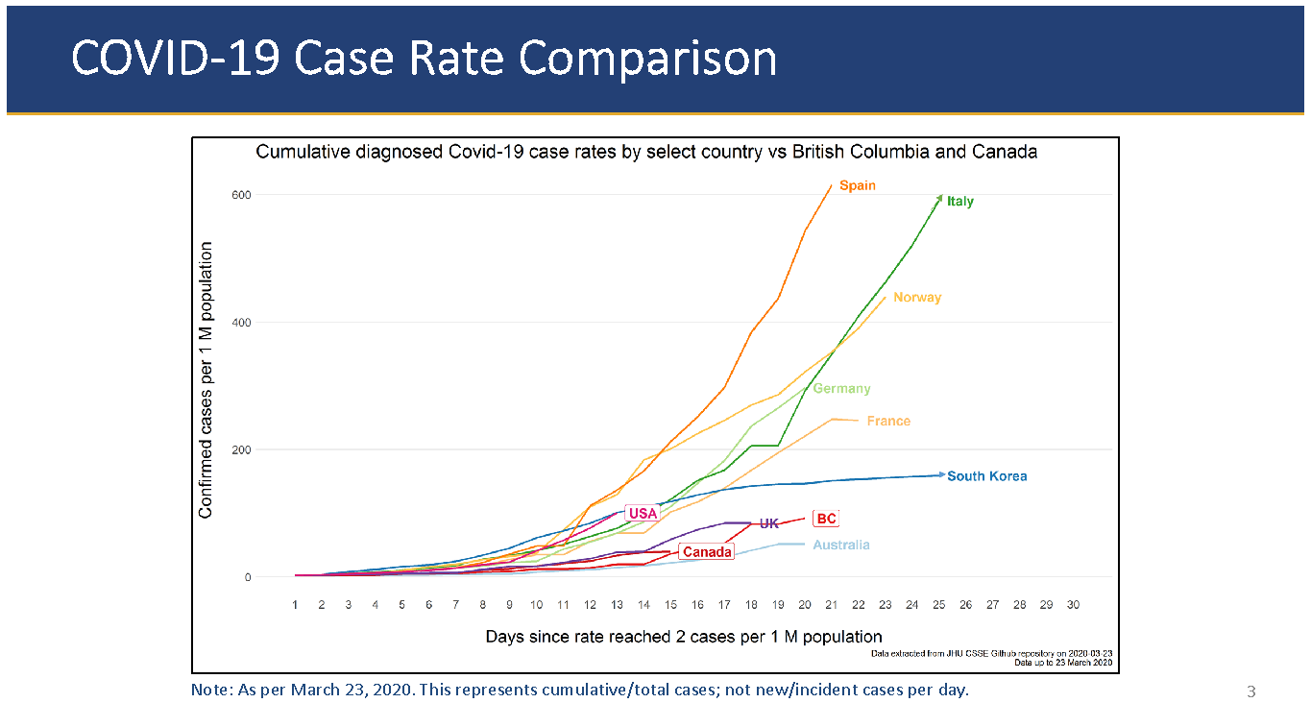
Technical Writing is also visual

Slide 8
What is Technical Communication?
The communication of specialized technical information – written, oral, or visual – that has specific and practical purposes and is usually designed for a particular audience. General purposes include
Informing (progress reports or status updates; documentation)
Instructing (instructions)
Persuading (proposals)
TRANSACTIONAL communication -- designed to fulfill a purpose (solve a problem)
READABLE – emphasis on document design for readability (user-friendly design)
Notes:
Can range from technical manuals to yoga instructions

Slide 9
WHY DO I HAVE TO LEARN ABOUT IT?

Slide 10
Why this course?
Poorly written resumes and cover letters are likely to doom a candidate’s chances of getting an interview
Writing remediation (fixing problems caused by poor writing) costs businesses in the U.S. almost $4 billion annually – possible up to $400 Billion in lost productivity! [1]
50% of private employers and 60% of state government employers say writing skills impact promotion decisions
Engineering accreditation board requires COMMUNICATION skills to be an integral part of an ENGR program – as one of the 12 Graduate Attributes

Slide 11
Is it really that important?
On average, professional engineers spend more than 50% of their job on communication tasks, such as writing memos, reports, emails, proposals, presentations, grant applications, etc. That percentage only increases as you move up in the ladder and grows exponentially if you remain in academia.
Nearly all job descriptions require excellent communication skills and the ability to work as part of a team.
By the end of this course, you will be able to produce a Co-op Work Term Report in IEEE style in response to a Request for Proposals, as well as properly format and compose professional memos and deliver effective presentations.

Slide 12
In a Professional Context
How Graduate Engineers spend their time:
25-50% problem solving of some kind
50-75% communicating (writing and reading reports, letter, emails, memos, proposals; discussions/meetings/presentations with colleagues, managers, clients, government, and the public [3]
Job performance evaluations and advancement depend more on communication skills than technical skills
70% of engineers and almost 50% of programmers rated the quality of their writing as either “very important” or “extremely important” to the performance of their jobs [4]

Slide 13
KEY FEATURES OF TECHNICAL WRITING

Slide 14
Conventions and Characteristics
There are important differences between academic and technical writing, including:
Audience
Purpose
Format
Tone
Writing Style

Slide 15
Technical v. Academic Writing
Writing for Work
Writing for School
Requires acute awareness of the need for strict security procedures
Poses legal liability for both the writer and the organization
May be read by readers unknown to the writer, inside or outside the organization, for an infinite time
Achieves job goals
Addresses a variety of readers who have different perspectives from those of the writer
Requires a variety of written documents
Security is limited to confidentiality of student records.
Primary liability, plagiarism, is limited to the writer.
Assignments are returned at the end of the semester.
Demonstrates knowledge gained
Addresses professor who has detailed knowledge of material
Limited variety of written documents

Slide 16
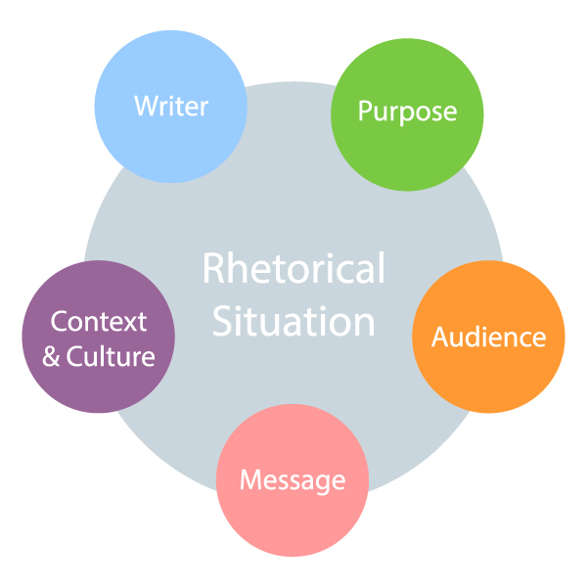
Technical Writing is Problem-Based and Reader-Centred
Before you can start to work on any problem, you must:
Understand your rhetorical situation
Do an audience and task analysis
Create an effective problem definition

Slide 17
Problem Definition post
Read Chapter 1.1 on Problem Definition and do Exercise 1.2 at the end of that chapter (using Hyman's Problem Formulation model). Post your response in the Problem Definition discussion topic as a New Thread. Comment on at least 3 of your classmates' posts. Indicate whether they have missed some aspect of the problem definition or if the ideas need refining.

Slide 18
Task Analysis
Effective task analysis will make your writing more focused and organized!
Read Chapter 1.1
Do Exercise 1.2 and post response to the appropriate thread
Demonstrate that you understand how to create a proper problem definition
Make a relevant comment on at least 3 of your classmates’ posts
Demonstrate that you understand how a problem definition could be improved

Slide 19
Document Design is key to Effective Technical Communication (and building ethos)
Make sure that your documents are as easy and efficient to read as possible by doing the following:
Make an immediate good impression: neat, readable, well-organized, and inviting document design
Format ideas for selective reading and logical sequence
Show the purpose and value of the document from the start
Use visuals when necessary
Convey an impression of credibility, thoroughness, and honest work
Make ideas clear to people who were not part of the initial readership
Enable people who need to use your writing to perform a task to do so

Slide 20
Fundamentals of Effective Workplace Communication
Planning the document: know your purpose and audience
Determining content: what do the readers need?
Arranging ideas
Drafting
Reviewing and Revising
Editing and Proofreading

Slide 21
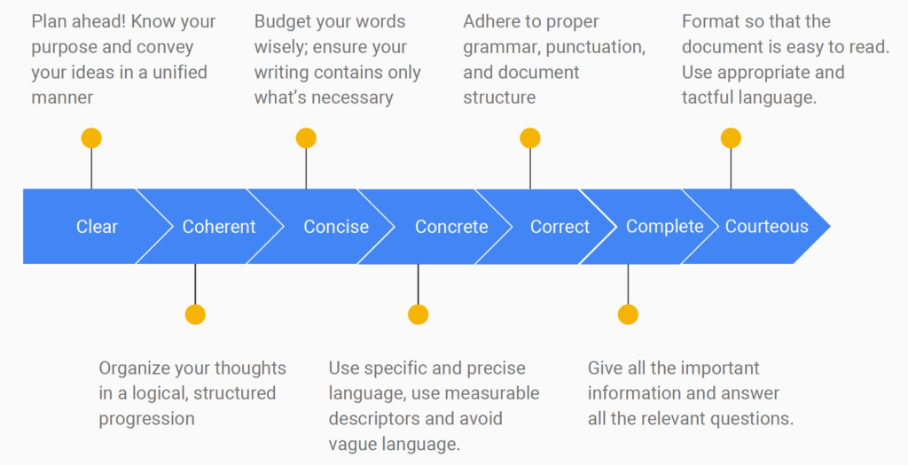
So how do we become effective technical writers?
Understand your rhetorical situation
Verbs, tone, and use the 7 Cs

Slide 22
How do I become a better technical writer?
Ask your favourite instructors for book, chapter, and article recommendations
Read widely
Academic articles
Books
Galatea 2.2 by Richard Powers
Leviathan Wakes by James S. A. Corey
The Martian by Martin Weir
Use technical writing skills in everyday situations (writing emails, etc)

Slide 23
Technical Communication is
Reader-centred: clear, courteous language, coherent document design and argument, and a constructive tone
Task-oriented: complete information and accurate analysis of the rhetorical situation
Problem-based: problem definition with a solution tailored to your readers’ specific needs

Slide 24
COURSE OVERVIEW

Slide 25
Major and Minor Assignments
Major Assignments: Memo, Proposal, Feasibility Study, Pair and Team Presentations
Milestones, Quizzes, Discussion Forum posts

Slide 26
For more information
Learn more about professional tone in Chapter 2
For more information on problem definitions, check out Chapter 1.1

